Slide 1
Sustainable Learning through Outdoor Activities
Arsakeio Lyceum of Patras (Greece)
Nikolaos Giannakopoulos, giannakopoulos.n@e-arsakeio.gr
Emmanouil Petrakis, lyk-p@arsakeio.gr
Olga Stavroulopoulou, stavroulopoulou.o@e-arsakeio.gr
Anastasios Psinas, psinas.a@e-arsakeio.gr
Nikolia Iliopoulou, iliopoulou.n@e-arsakeio.gr
Ilias Karadimas, karadimas.i@e-arsakeio.gr
Andreas Giannakopoulos, giannakopoulos.a@e-arsakeio.gr

Slide 2
INTRODUCTION
Necessity – Objectives
Actions & Implementation Timeline
Success criteria for the Action
EXAMPLES OF PROMOTING SUSTAINABILITY IN SCHOOL
Promoting biodiversity in school outdoor areas
Encouraging students to conserve energy and minimize plastic and paper waste
Collect weather data
EXCHANGE GOOD ENVIRONMENTAL PRACTICES THROUGH EUROPE
Initiate Sustainability Challenges and Competitions
Conclusion

Slide 3
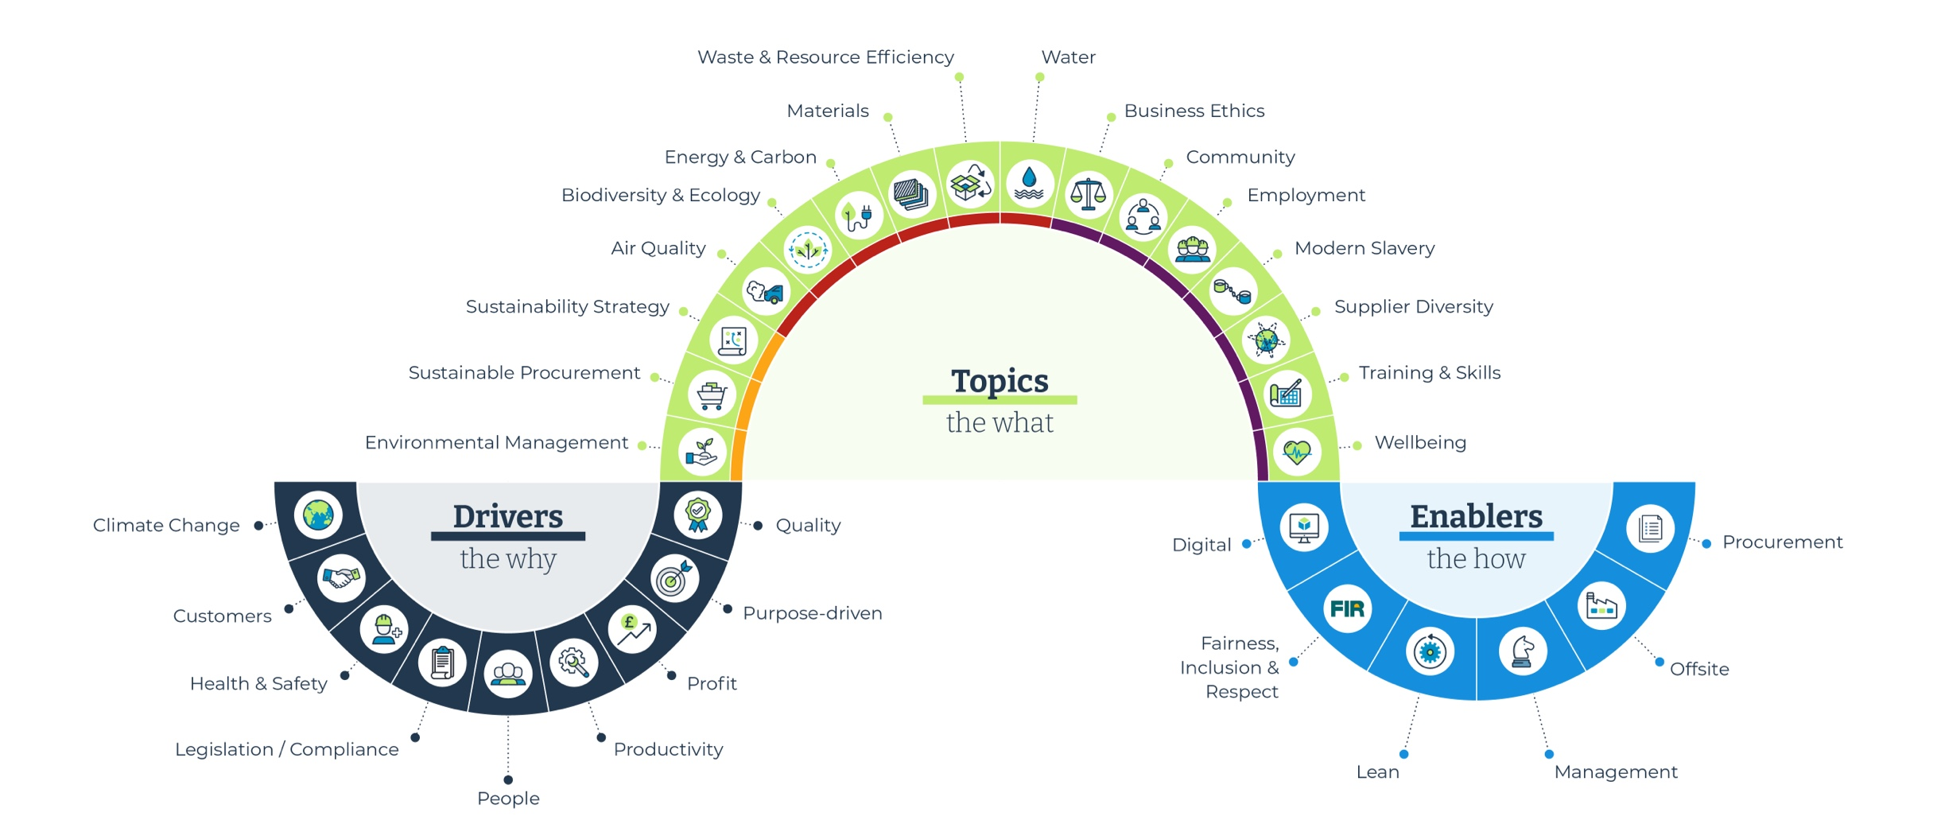
SUSTAINABLE SCHOOL is a visionary school that operates as a community^{[1]} . It is based on communication and collaboration among all members of the school community, and in the everyday school life. It provides opportunities for everyone (students, educators, administration, parents, local community) to engage with common goals and their sustainable management in a spirit of teamwork and participation^{[2]}.
https://images.app.goo.gl/PLQQPgxnYG4decuC8 [Accessed 10/6/2024]
https://images.app.goo.gl/w8FBUy8XQLEmvJsE9 [Accessed 10/6/2024]
[1] UNESCO. 2012. UNESCO & Sustainable Development. https://unesdoc.unesco.org/ark:/48223/pf0000216383 (English), [Accessed 10/3/2024]
[2] Society for the environment and cultural heritage (n.d.). Sustainable Greek School.

Slide 4
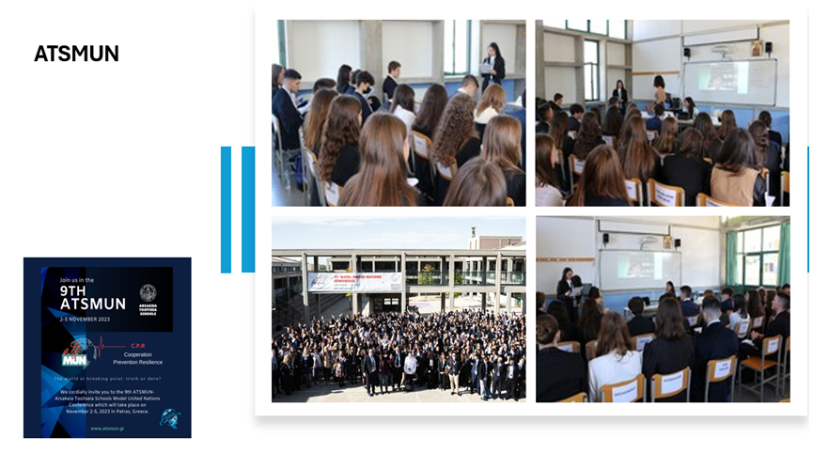
We focus on the holistic transformation of the school into a learning and collaboration organization, and based on this vision, we have built the philosophy of the Sustainable School action plan:
“Everyone Cares, Everyone Participates”
Another key objective for our team is to become a connecting link among various partners who are driven by our common vision or serve some aspect of it. Our partners include educators from participating schools, education officials, university professors, experts, members of other programs, educational services, etc. Each partner contributes with their specific expertise and competencies.

Slide 5
For the better organization of the sustainable school, the introduction of sustainability has been organized around eight pillars of sustainability:
Democracy and participation in the school.
b) Improvement of the learning framework.
c) Promotion of culture and arts in the school.
d) Sustainable building and increasing biodiversity in the school.
e) Policy for energy conservation and transportation to and from the school.
f) Rational management of natural resources (water, materials, and waste).
g) Promotion of health in the school.
h) From local to global scale.

Slide 6
The qualitative criteria for sustainability in the school encompass several key areas.
First, it emphasizes active participation and collaboration by facilitating the involvement of all school community members in decision-making and encouraging collaborative actions and initiatives.
Second, it highlights the importance of democratic processes through transparent and equitable decision-making.
Third, it focuses on ensuring quality education by incorporating sustainability principles into high-quality educational programs and continuously improving and adapting educational methods and content.
Fourth, it underscores the need for social and environmental awareness by integrating these aspects at all educational levels and developing actions that promote social responsibility and ecological consciousness.
Fifth, it advocates for a holistic approach that links sustainability with all aspects of school life, integrating sustainability principles into all school activities and operations.
Sixth, it calls for continuous professional development by providing opportunities for the ongoing training of educators on sustainability issues and promoting lifelong learning for all school community members.
Lastly, it emphasizes the importance of evaluation and feedback through systematic assessment of sustainability actions and programs, using feedback for continuous improvement and adaptation of strategies.

Slide 7
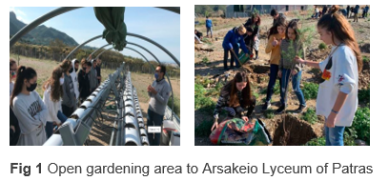
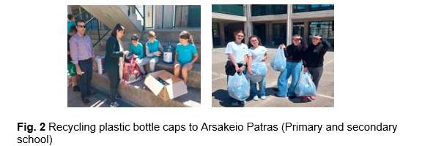
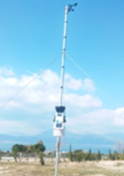
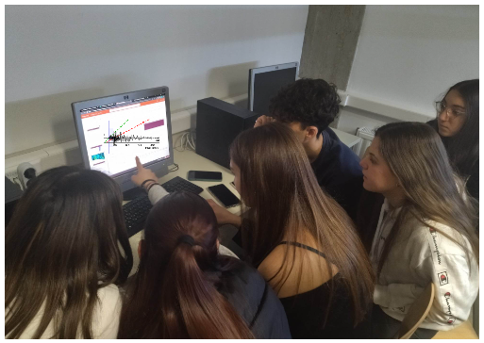
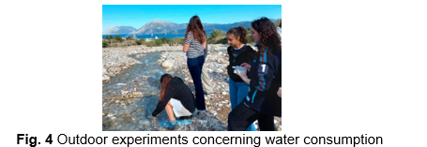
EXAMPLES OF PROMOTING SUSTAINABILITY IN SCHOOL
Establishing a small vegetable garden allows children to learn about growing their own food and experience the joy and fulfillment of observing plants thrive.
Paper and plastic are among the most heavily used materials in schools, so it is crucial to promote their reduction not only among students but also among teachers and administrative staff.
A simple but effective environmental activity for kids that helps the wide world of science, collecting weather data for the Community Collaborative Rain, Hail, and Snow Network draws on those data and analysis skills while helping students to make predictions and see real-world connections to the work they’re doing in math and science class.
Nature walks and similar activities provide valuable hands-on experiences that strengthen students' connections to the environment, encouraging them to move beyond merely discussing sustainability to actively engaging with it.
Fig. 3 Meteorological and seismological station to Patras

Slide 8
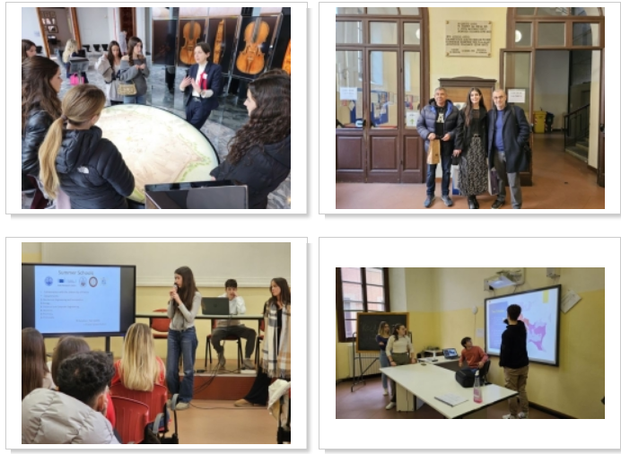
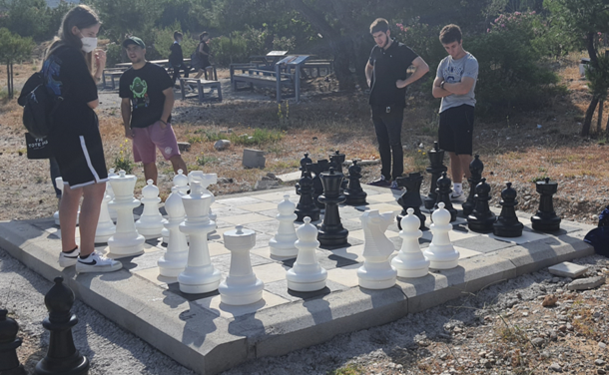
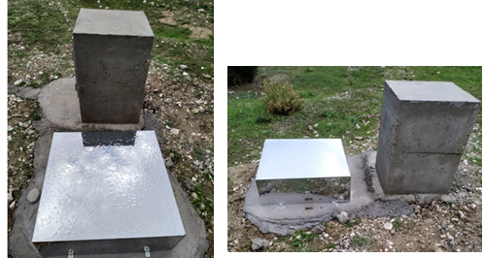
EXAMPLES OF PROMOTING SUSTAINABILITY IN SCHOOL
Hearing from professionals or other students in the field of sustainability, provides real-world perspectives and insights, making environmental issues more tangible and relatable. Additionally, these experts can help educators fill in any knowledge gaps, thereby creating a stronger foundation for future class discussions on environmental stewardship.
Fig. 6 Τwinning with the Classical Lyceum Manin of Cremona
Fig. 7 Outdoor chessboard and sundial in our school outdoor open classes
Fig. 8 Cosmic ray detection device

Slide 9
Gamification
Engage with students’ interest to inspire collaborate, share and interact with educational scenarios that promote environmental knowledge & awareness through an innovative virtual environment.
Raising environmental​ knowledge & awareness​
through an innovative virtual environment​

Slide 10
These are just a few of the many steps that can be taken immediately to make schools more sustainable.
These suggestions are simple, resource-efficient, and likely to receive support from parents. Teaching children sustainable practices from a young age will help future adults make more conscious and environmentally aware decisions.
Encourage and inspire your students to adopt a more sustainable lifestyle and to take action against climate change.
https://images.app.goo.gl/9UYQEiNEhEoATqTcA [Accessed 10/6/2024]

Slide 11
Sustainability team members of Arsakeio School of Patras
"Many hands make light work"

Slide 12
"Distinctions from Greek sustainability nonprofit organizations"
For further information about our school :
Visit our website (in Greek) : https://www.arsakeio.gr/gr/patra/patra-high-school
Visit our facebook profile (in Greek) : https://www.facebook.com/ArsakeioPatras/
Visit our Instagram profile (in Greek) : https://www.instagram.com/arsakeio_patras?igsh=OGdjMHRqeHVsMXEy
For further collaboration :
lyk-p@arsakeio.gr
giannakopoulos.n@e-arsakeio.gr
Τhank you very much for your attention!!!

